Slide 1
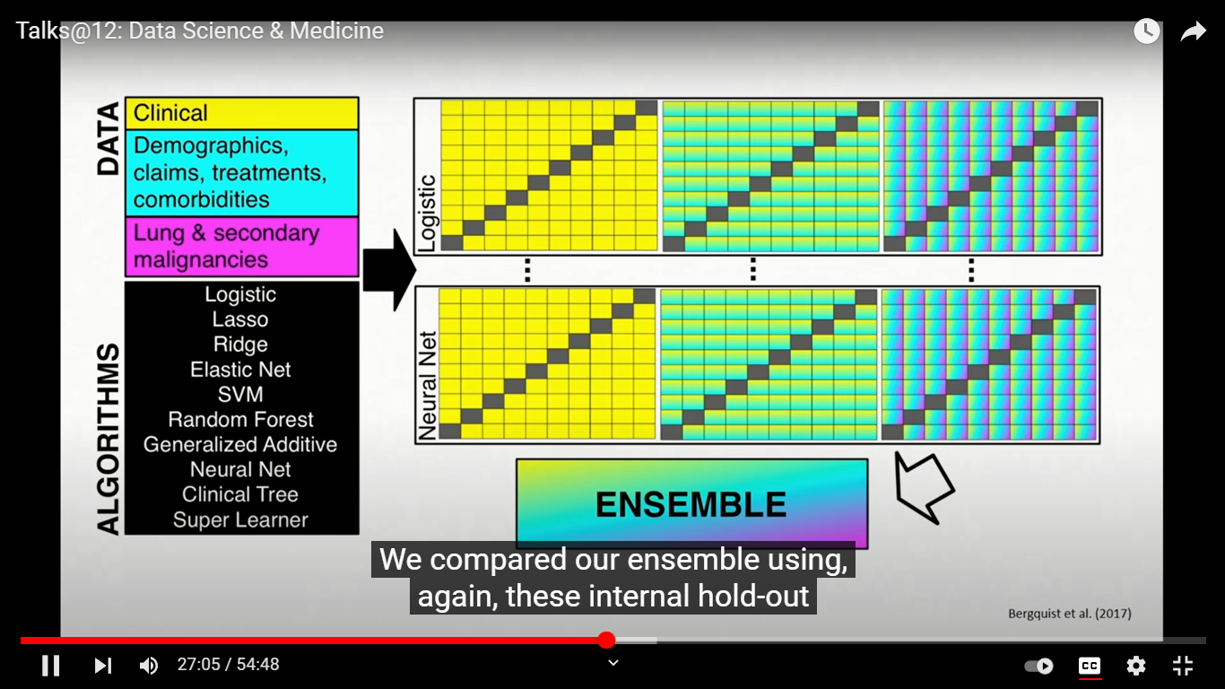

Slide 2
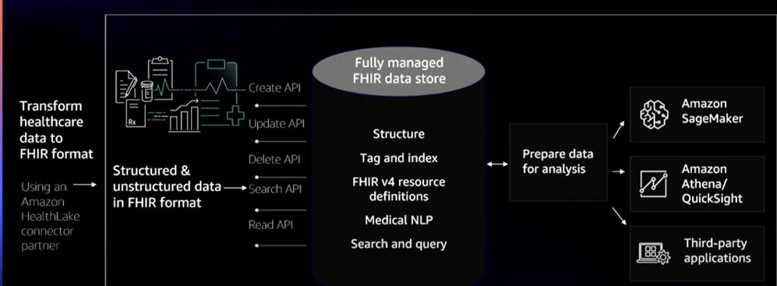
Notes:
https://www.youtube.com/watch?v=RFYCpNF9_Yw

Slide 3
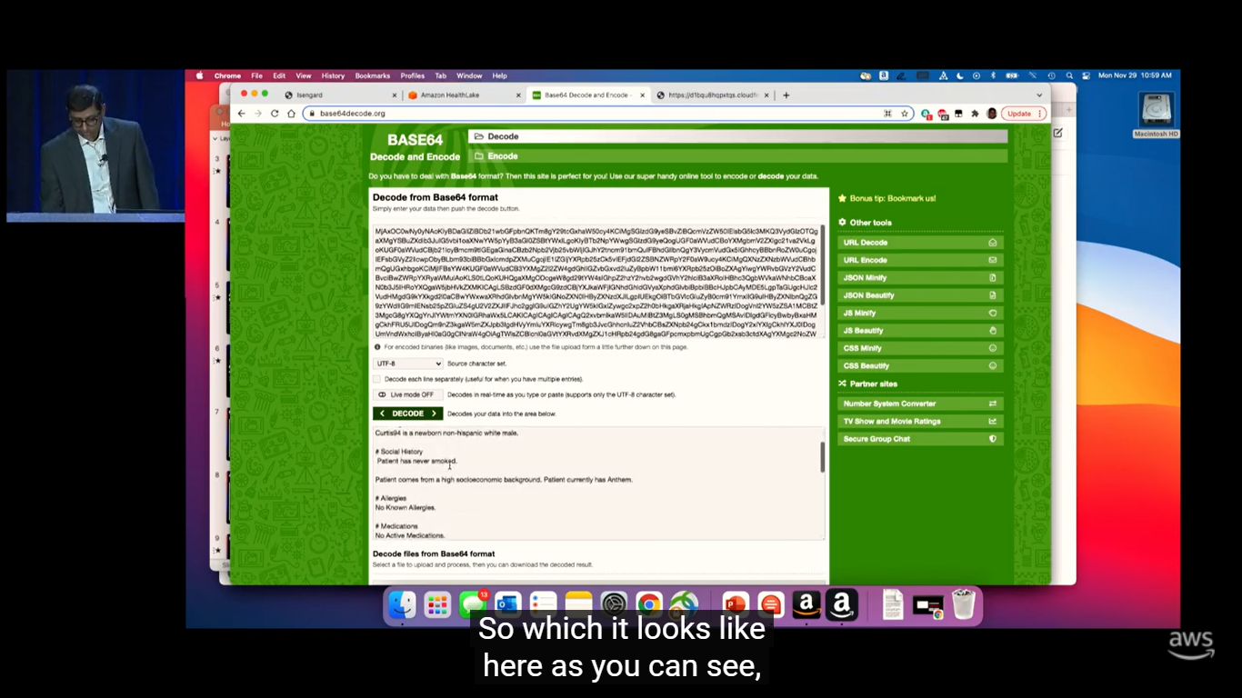
Notes:
Decode documetreference

Slide 4
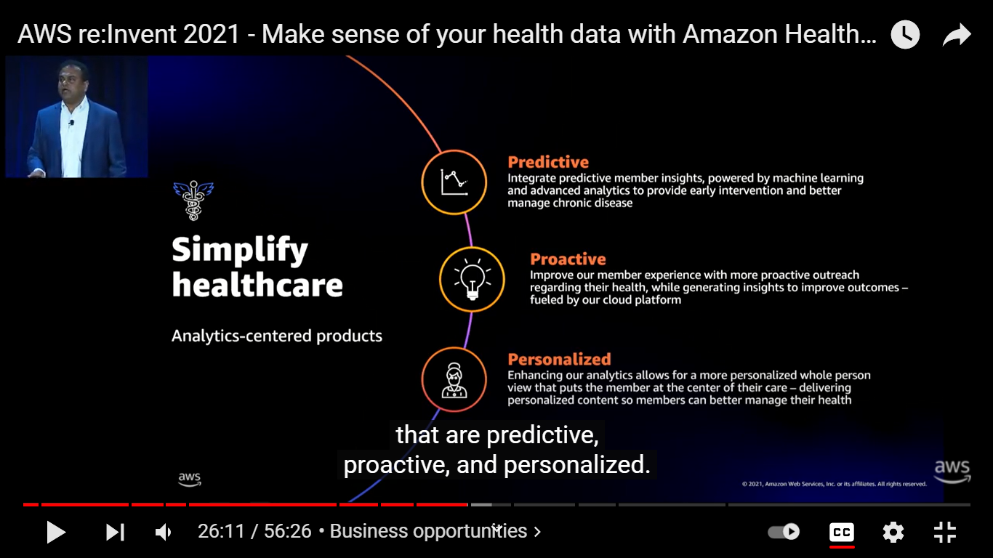

Slide 5
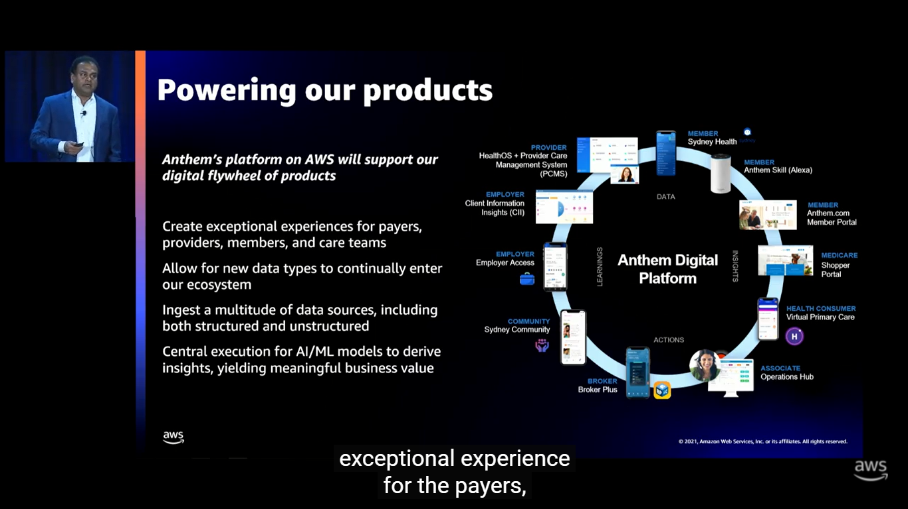

Slide 6
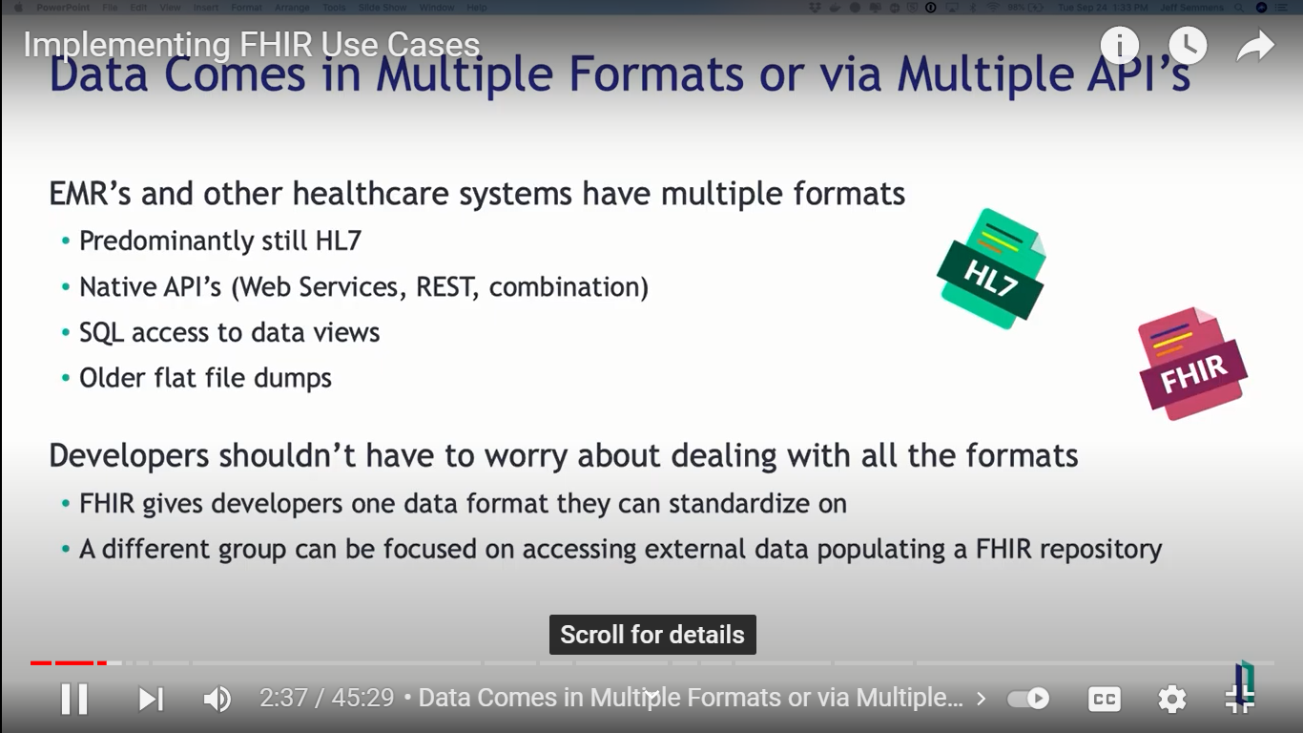
Notes:
What are the data formats the EMR system sends in Kipu?

Slide 7
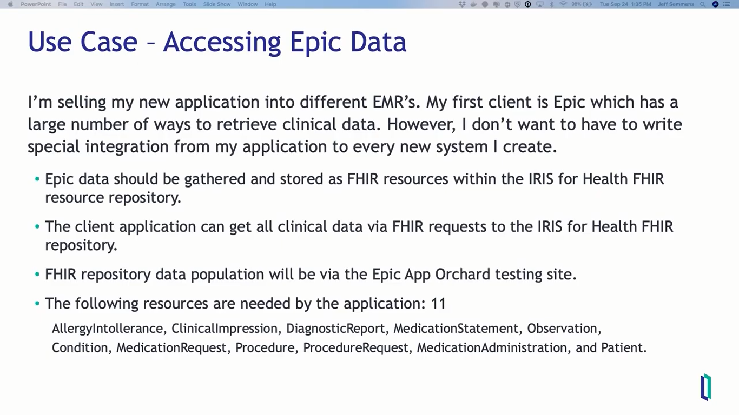
Notes:
https://www.youtube.com/watch?v=NKW4p3EqiYA

Slide 8
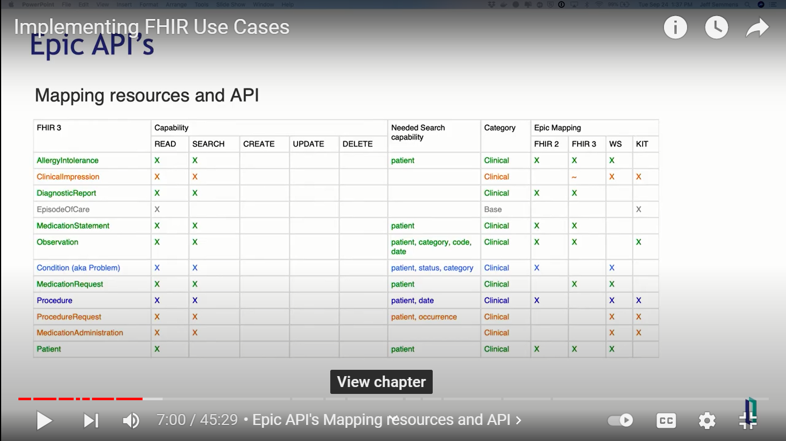

Slide 9
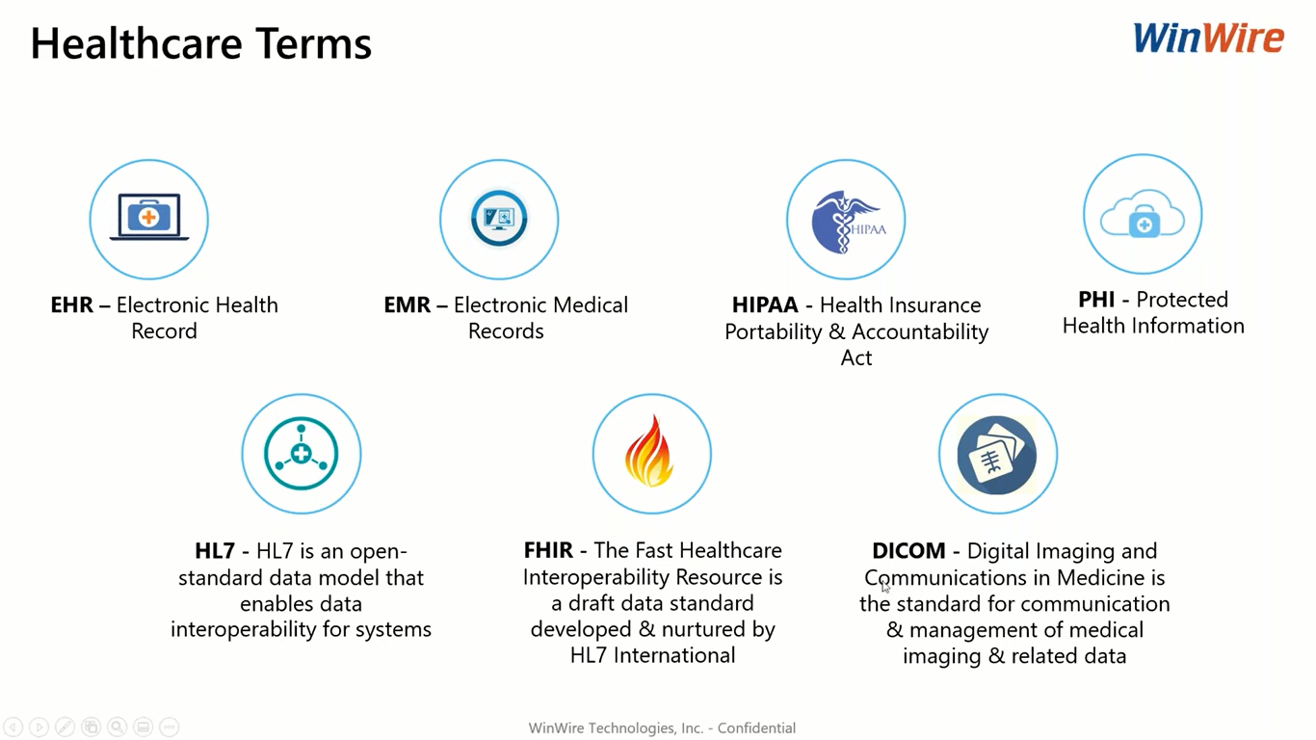

Slide 10
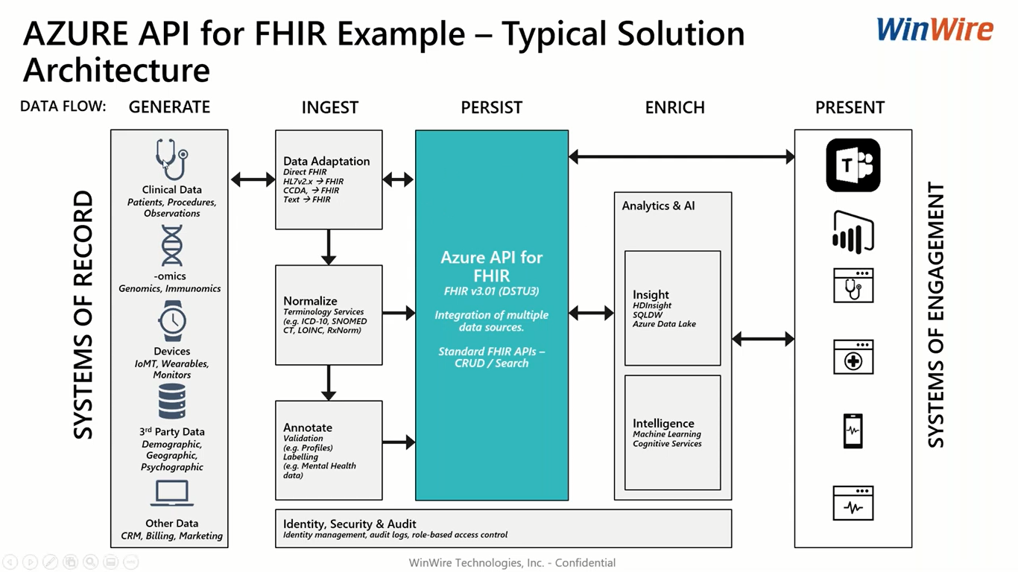
Notes:
https://www.youtube.com/watch?v=8PKRyTFiplM

Slide 11
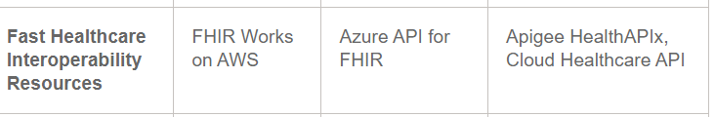
Service | AWS | AZURE | GCP
https://aws.amazon.com/solutions/implementations/fhir-works-on-aws/
https://docs.microsoft.com/en-us/azure/healthcare-apis/azure-api-for-fhir/overview
https://cloud.google.com/healthcare-api
Notes:
Comparison - https://www.techtarget.com/searchcloudcomputing/feature/A-cloud-services-cheat-sheet-for-AWS-Azure-and-Google-Cloud

Slide 12
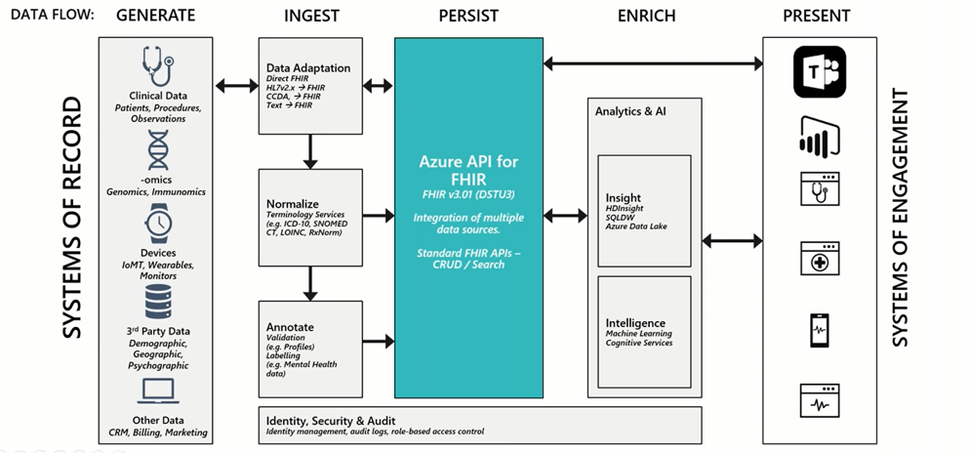

Slide 13
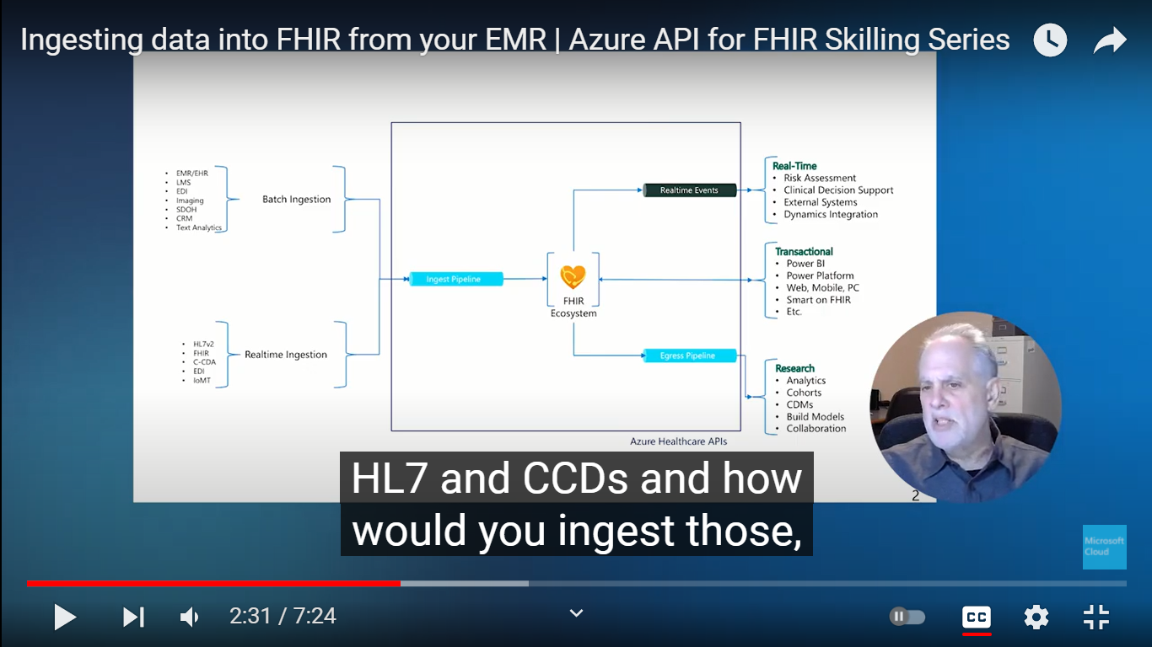

Slide 14
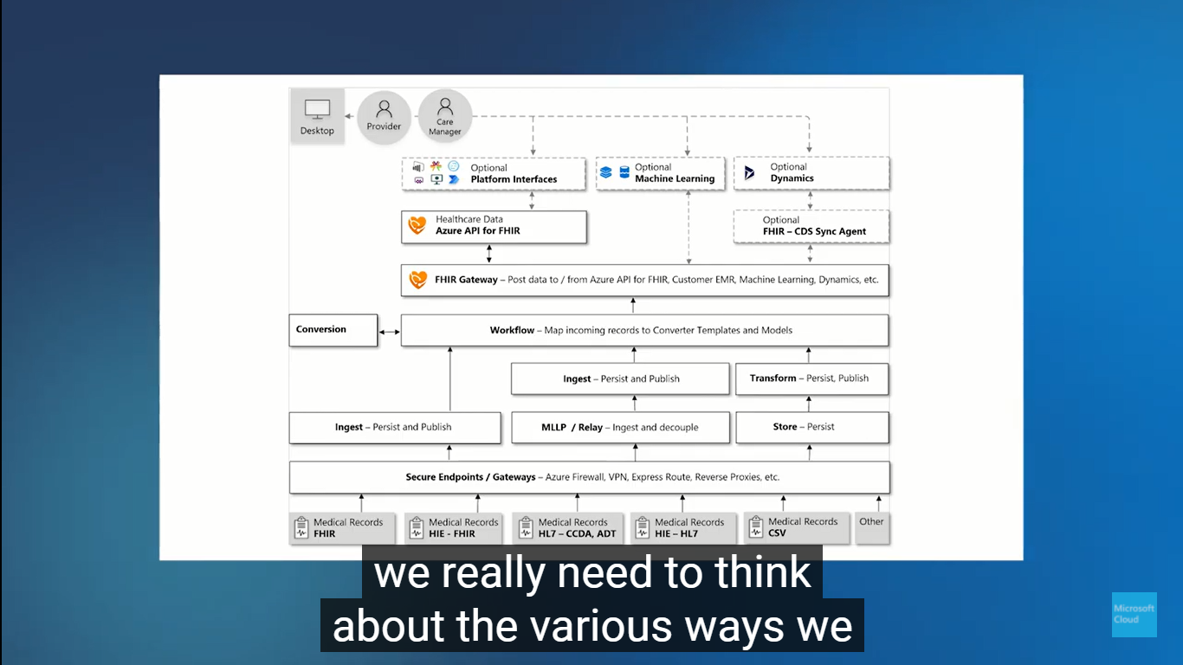

Slide 15
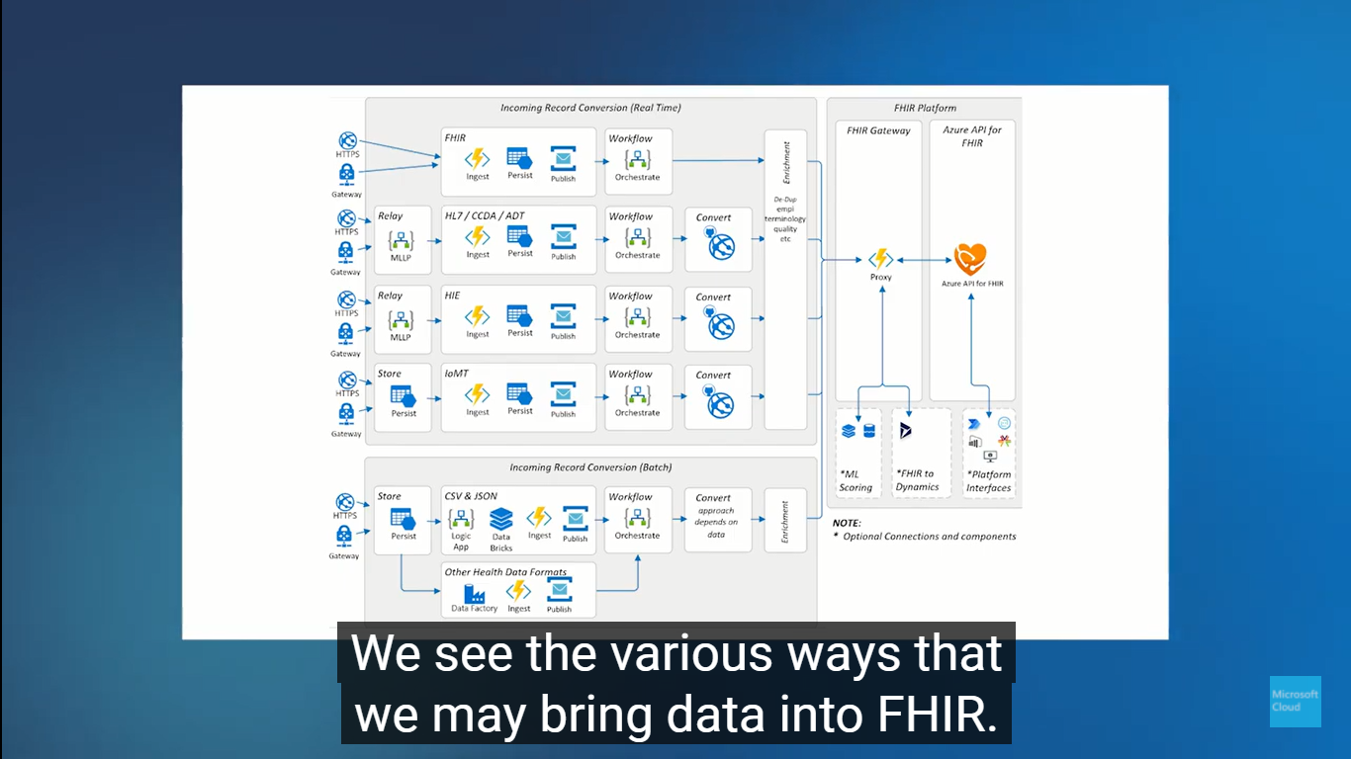

Slide 16
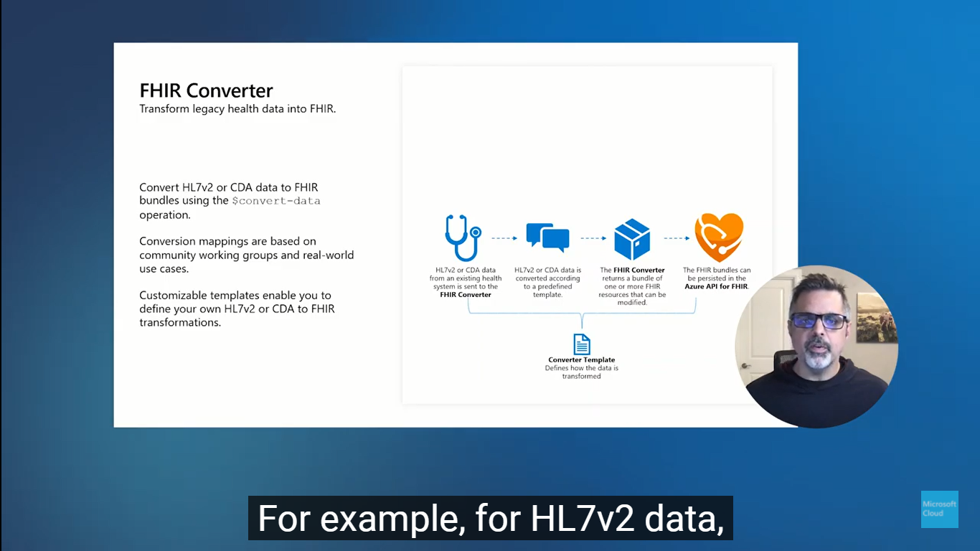
Notes:
https://www.youtube.com/watch?v=I8tB98LtULU

Slide 17
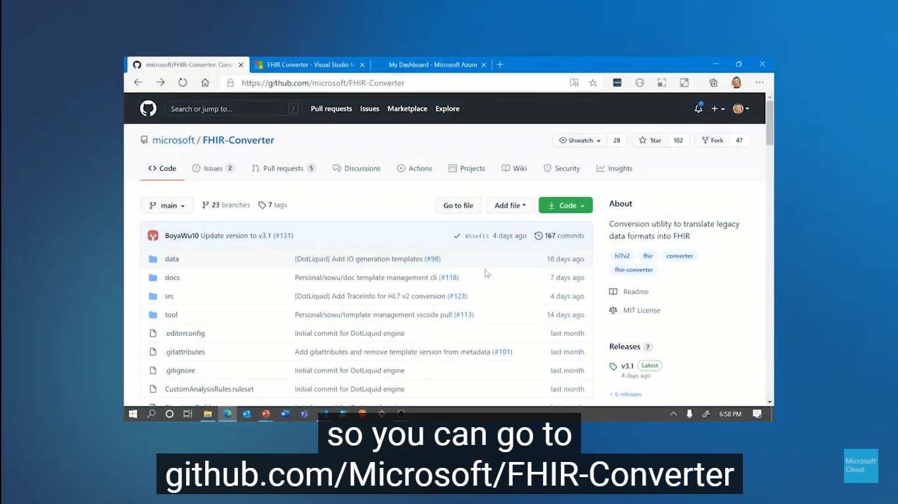
Notes:
https://github.com/microsoft/FHIR-Converter

Slide 18
Data transformation from any format to FIHR

Slide 19
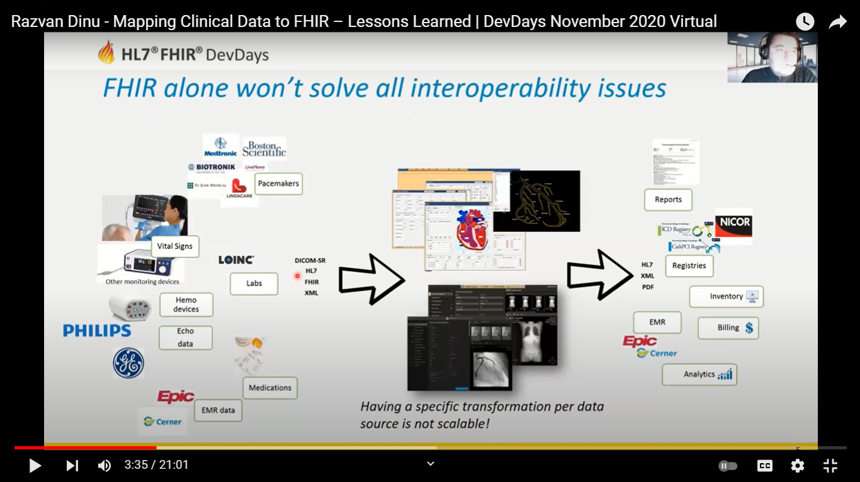
Notes:
https://www.youtube.com/watch?v=SuzmoP_vhHQ

Slide 20
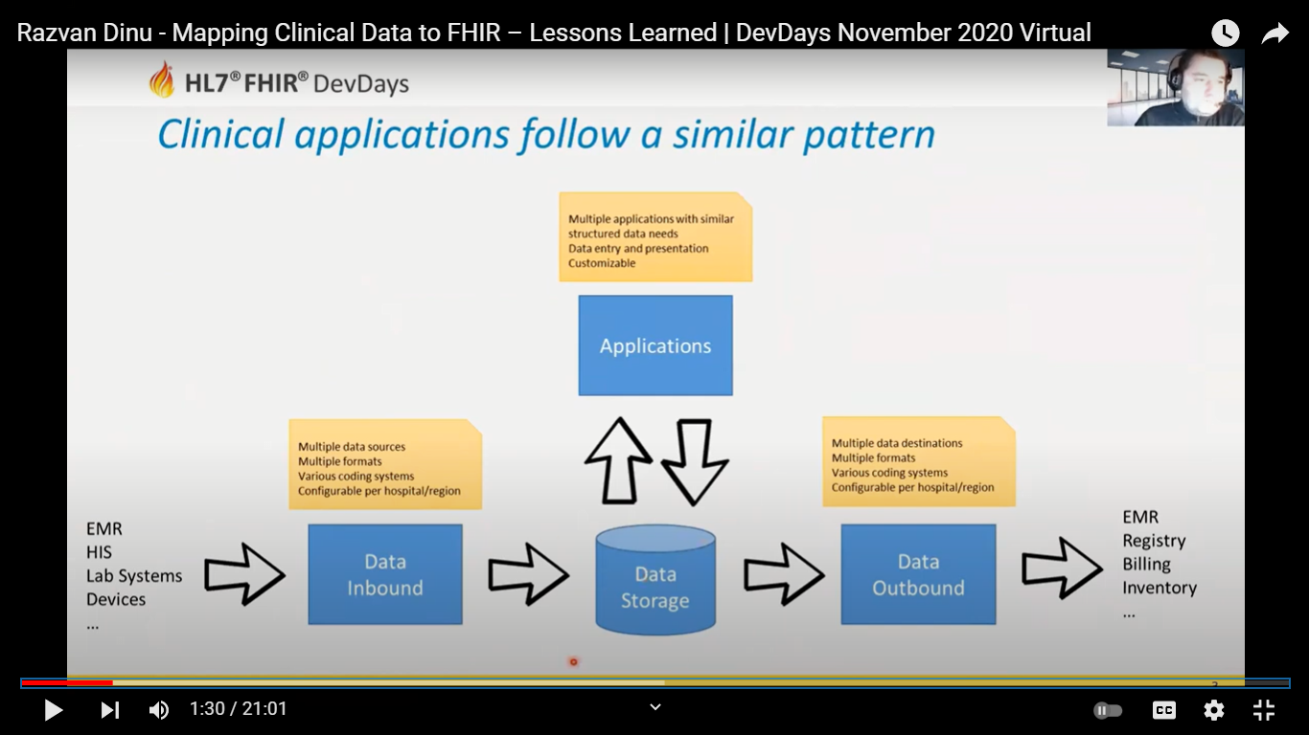

Slide 21
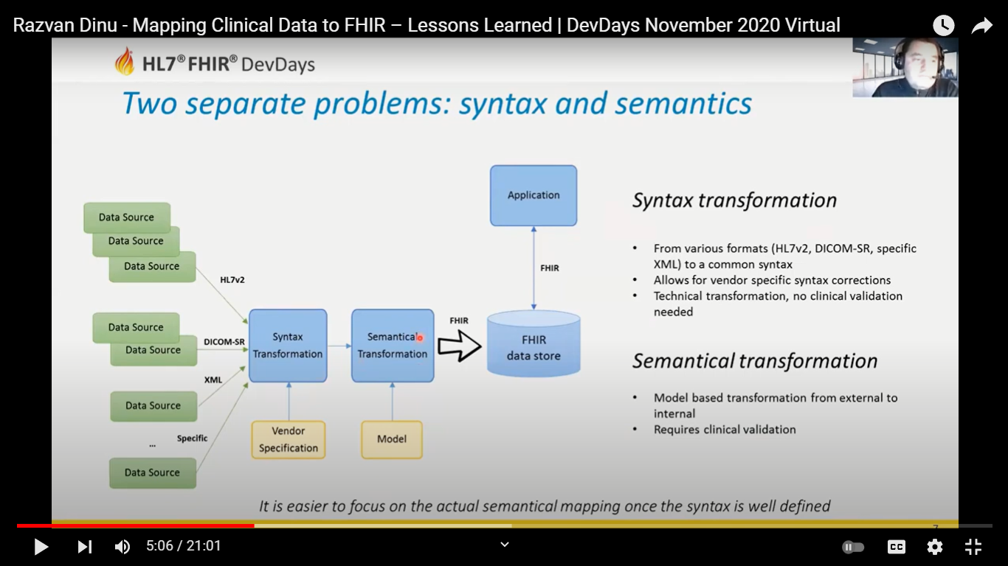

Slide 22
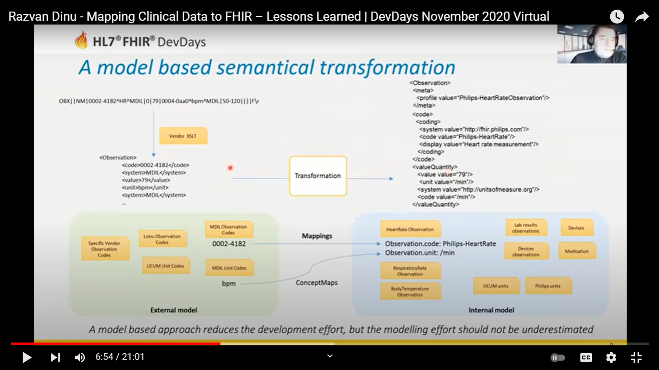

Slide 23
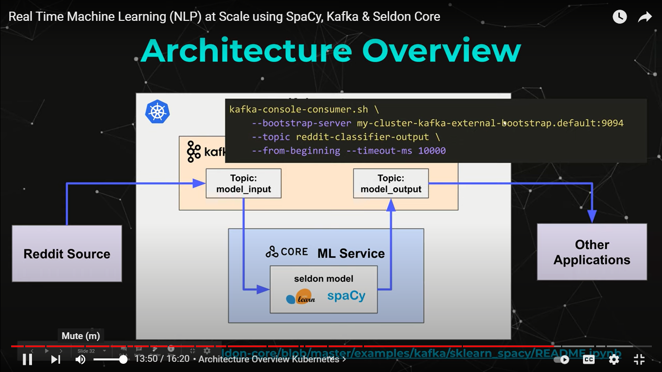
Notes:
https://www.youtube.com/watch?v=T0pPn5KTxFE

Slide 24


